Slide 1
Specialist Diploma In Data Science (AI) - SP IT8303 – AI Human Interface – CA1 Submission Deep Learning by CNN for Image Classification Using Keras 2024/2025 Semester 2
By Lo Ka Fai Submission:29 Nov 2024

Slide 2
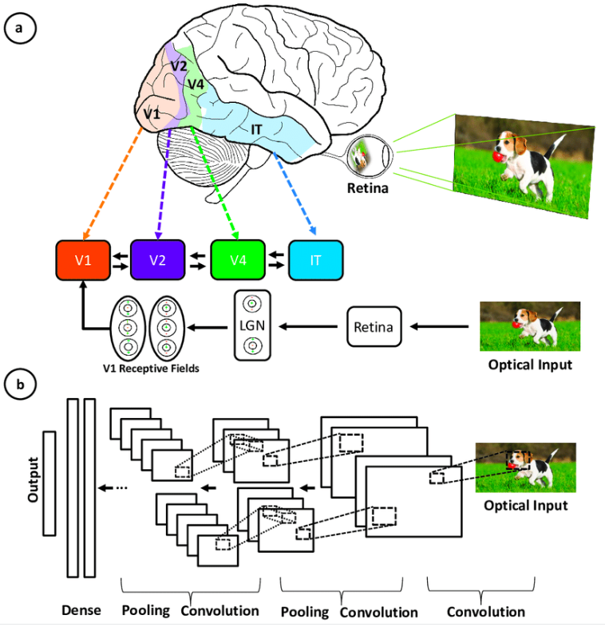
Intro of CNN (Convolutional Neural Network)
A Convolutional Neural Network (CNN), also known as ConvNet, is a specialized type of deep learning algorithm mainly designed for tasks that necessitate object recognition, including image classification, detection, and segmentation. CNNs are employed in a variety of practical scenarios, such as autonomous vehicles, security camera systems, and others.
Convolutional neural networks were inspired by the layered architecture of the human visual cortex, and below are some key similarities and differences.

Slide 3
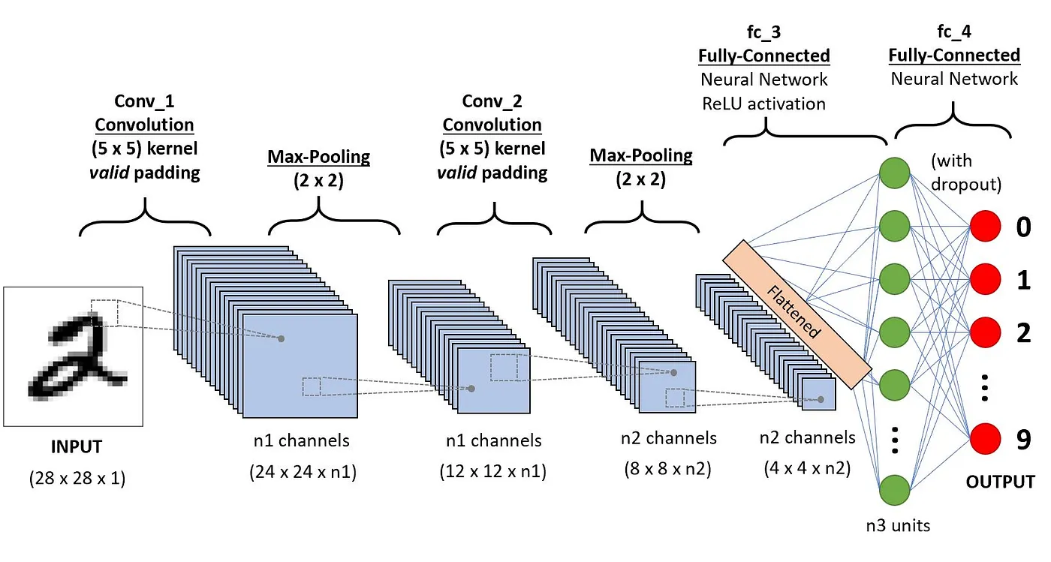
Intro of CNN (Convolutional Neural Network)
Key Components of CNNs:
Convolutional Layers: The core of a CNN, convolutional layers apply filters (small matrices) to input data to detect specific features, like edges or textures. This process helps reduce the dimensionality while preserving important spatial information.
Pooling Layers: Pooling (often max-pooling) layers reduce the spatial size of the feature maps, lowering computational costs and making the network more robust to small changes and distortions in the input.
Fully Connected Layers(Dense): After a series of convolutional and pooling layers, the data is usually flattened and passed through one or more fully connected (dense) layers. These layers combine features to predict the final output, like classifying an image.
Activation Functions: Non-linear functions like ReLU (Rectified Linear Unit) are commonly applied after each convolution to introduce non-linearity, enabling the network to model complex relationships.

Slide 4
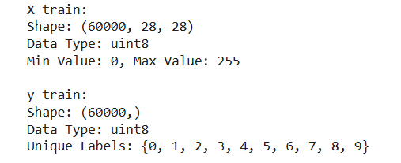
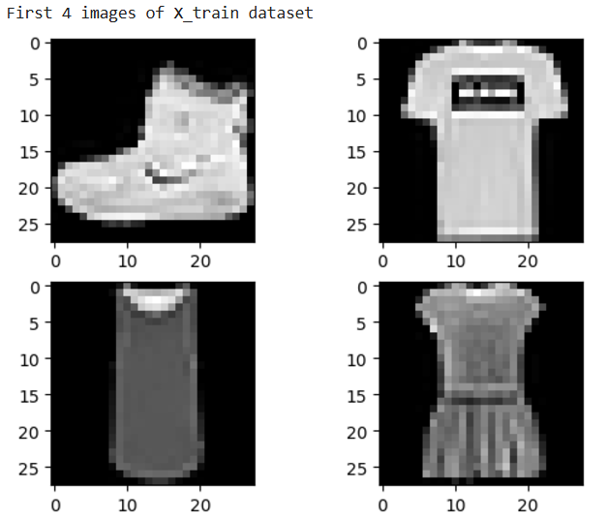
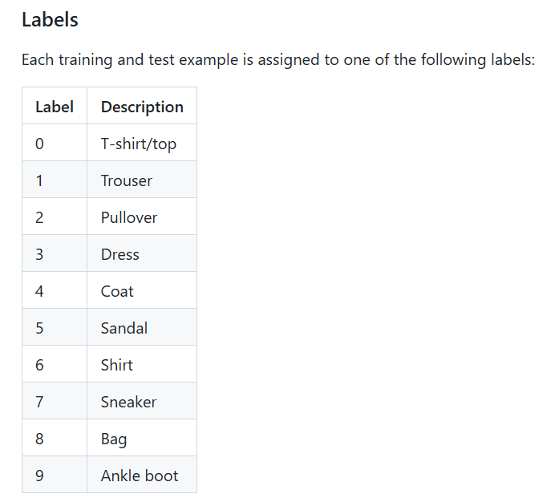
Info of Fashion-Mnist Dataset
EDA of X_train and y_train dataset
First 4 images (labels) in Fashion-MNIST dataset (X_train)

Slide 5
Data Preprocessing (Python)
Feature Engineering - Baseline CNN model (A0)
Image Configuration
# Configure input image format
# 'channels_first' means the color/pixel dimension comes first
K.set_image_data_format('channels_last')
# Set fixed random seed for reproducibility
seed = 42
np.random.seed(seed)

Slide 6
Data Preprocessing (Python)
Reshaping Data
# Reshape data to match Conv2D input requirements
# reshape to be [samples][width][height][pixels]
X_train = X_train.reshape(X_train.shape[0], 28, 28, 1).astype('float32')
X_test = X_test.reshape(X_test.shape[0], 28, 28, 1).astype('float32’)
Normalization
# Normalize pixel values (from 0-255 to 0-1)
X_train /= 255
X_test /= 255
One-Hot Encoding
# Convert class labels to binary class matrix (one-hot encoding)
y_train = to_categorical(y_train)
y_test = to_categorical(y_test)
num_classes = y_test.shape[1]

Slide 7
CNN Model Architecture (Python)
Modelling - Baseline CNN model (A0)
# Create CNN model
model = Sequential()
# First Convolutional Layer
model.add(Conv2D(32, (5, 5), input_shape=(28, 28, 1), activation='relu'))
# Max Pooling Layer
model.add(MaxPooling2D(pool_size=(2, 2)))
# Dropout Layer
model.add(Dropout(0.2))
# Flatten Layer
model.add(Flatten())
# Fully Connected Hidden Layer
model.add(Dense(128, activation='relu'))
# Output Layer
model.add(Dense(num_classes, activation='softmax'))

Slide 8
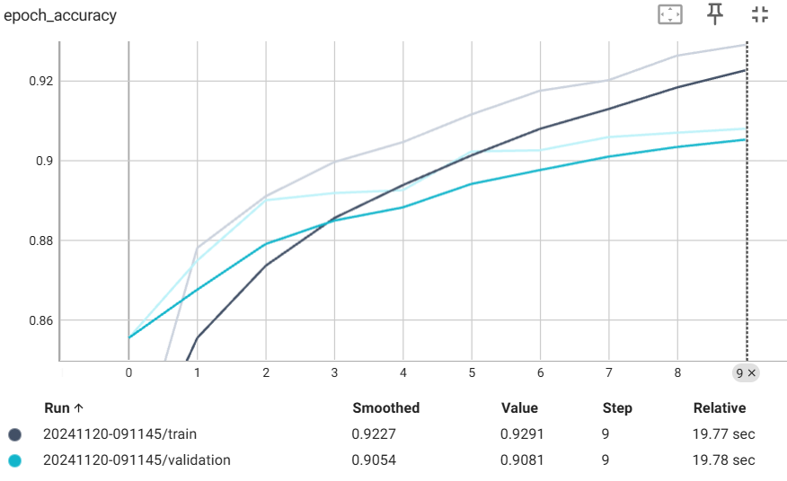
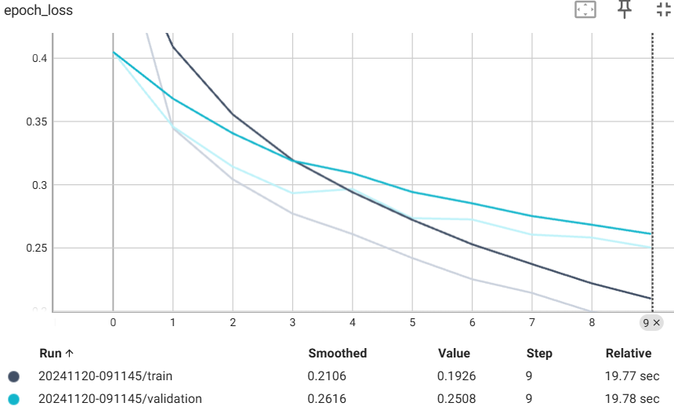
CNN Model Training
A0 – Baseline CNN model :
# compile the model, categorical_crossentropy for multi-class classification
# adam optimizer for adaptive learning rate
model.compile(loss='categorical_crossentropy', optimizer='adam', metrics=['accuracy’])
# Train the Model (10 epochs)
model.fit(
X_train, y_train,
validation_data=(X_test, y_test),
epochs=10,
batch_size=200,
callbacks=[tensorboard_callback], verbose=2
)
Note: Plots on the right are generated by TensorBoard

Slide 9
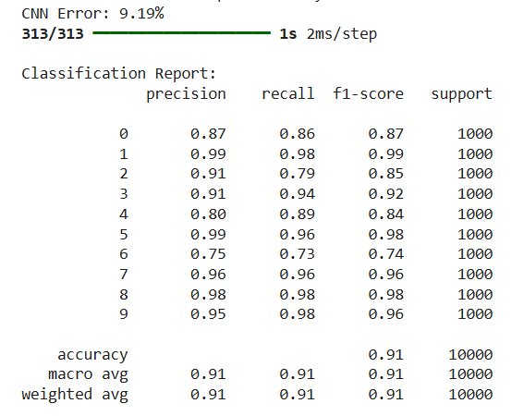
CNN Model Evaluation
A0 – Baseline CNN model Classification Report :
# Evaluate the Model performance
scores = model.evaluate(X_test, y_test, verbose=0)
print("CNN Error: %.2f%%" % (100 - scores[1] * 100))
# Classification Report
# Predict the classes for test data, use argmax to convert one-hot encoded prediction vector into an integer class label
y_pred = np.argmax(model.predict(X_test), axis=-1)
# Convert y_test from one-hot encoded format to class labels
y_test_labels = np.argmax(y_test, axis=-1)
print("\nClassification Report:")
print(classification_report(y_test_labels, y_pred, target_names=[str(i) for i in range(num_classes)]))
Train Accuracy: 0.9291, Validation Accuracy: 0.9081
Train Loss: 0.1926, Validation Loss: 0.2508
Accuracy: 0.91
CNN Error: 9.19%

Slide 10
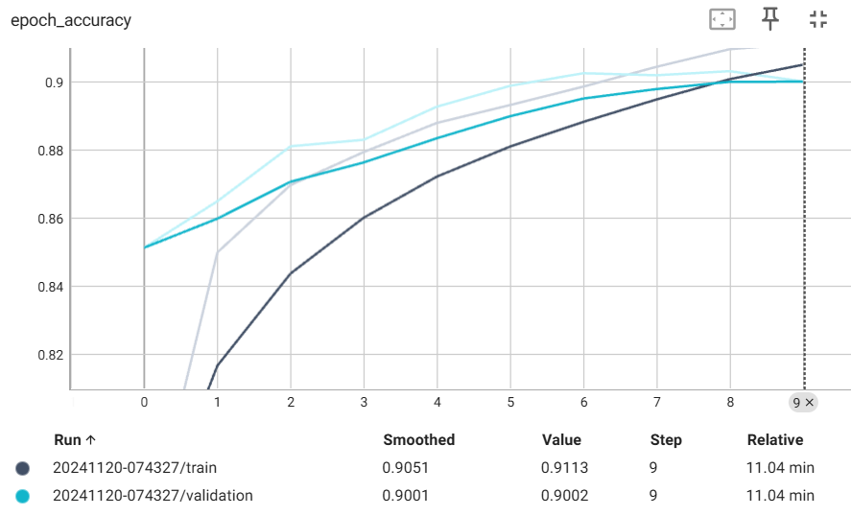
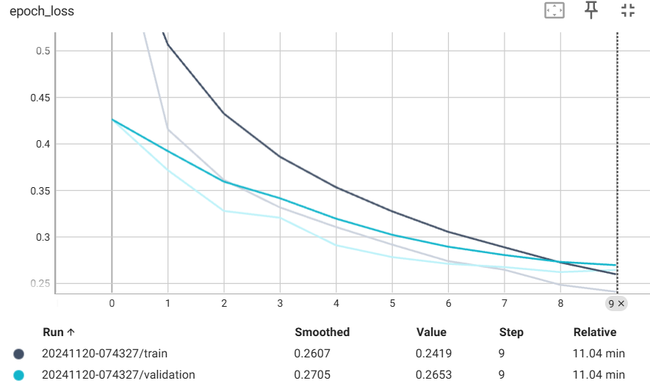
CNN Model Training
A1 – CNN model architecture:
2 Conv2D layers (32,5,5) (64,3,3)
2 Macpooling2D (2,2)
2 Dropout (0.2, 0.3)
1 Flatten
1 Dense layers (128)
Training (10 epochs)
Train Accuracy: 0.922, Validation Accuracy: 0.9095
Train Loss: 0.2113, Validation Loss: 0.2502

Slide 11
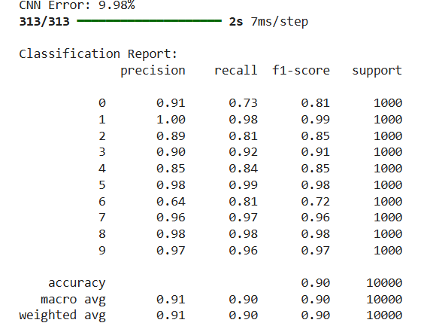
CNN Model Evaluation
A1 – CNN model Classification Report :
Accuracy: 0.90
CNN Error: 9.98%

Slide 12
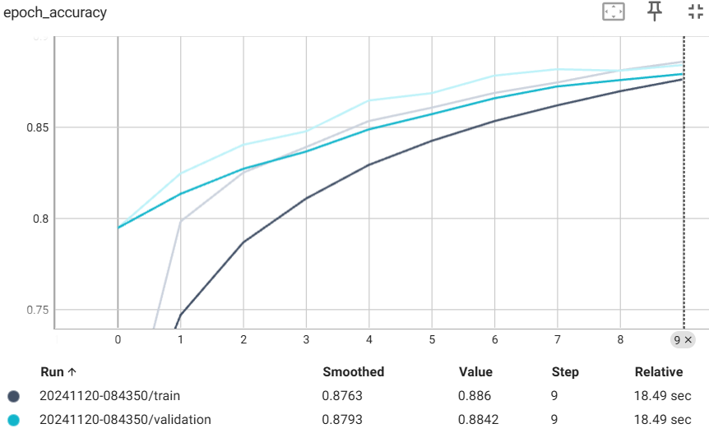
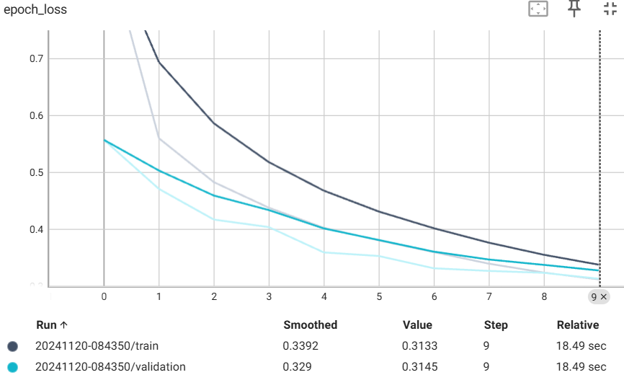
CNN Model Training
A2 – CNN model architecture :
3 Conv2D layers (32,5,5) (64,3,3) (128,3,3)
3 Maxpooling2D (2,2)
2 Dropout (0.3, 0.4)
1 Flatten
1 Dense layers (128)
Training (10 epochs)
Train Accuracy: 0.886, Validation Accuracy: 0.8842
Train Loss: 0.3133, Validation Loss: 0.3145

Slide 13
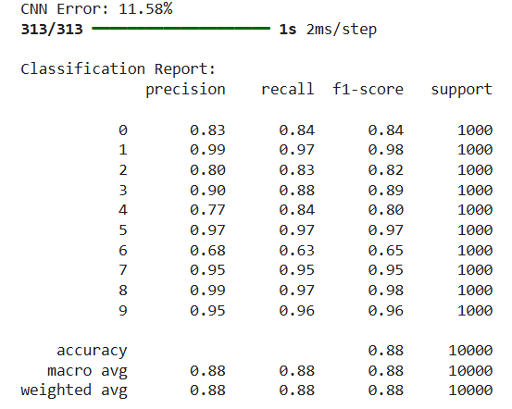
CNN Model Evaluation
A2 – CNN model Classification Report :
Accuracy: 0.88
CNN Error: 11.58%
Accuracy and CNN Error are underperformed the previous model A1

Slide 14
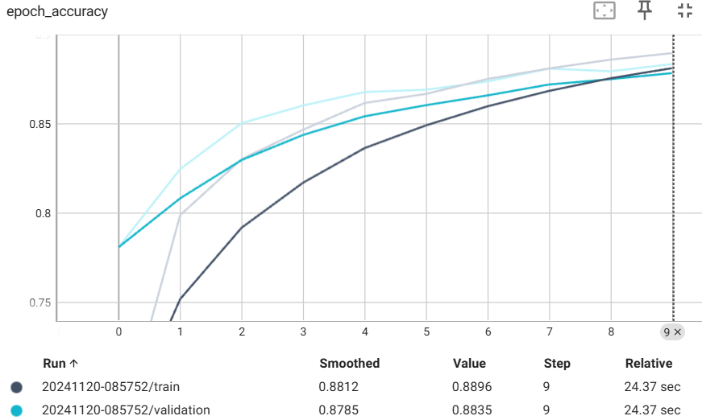
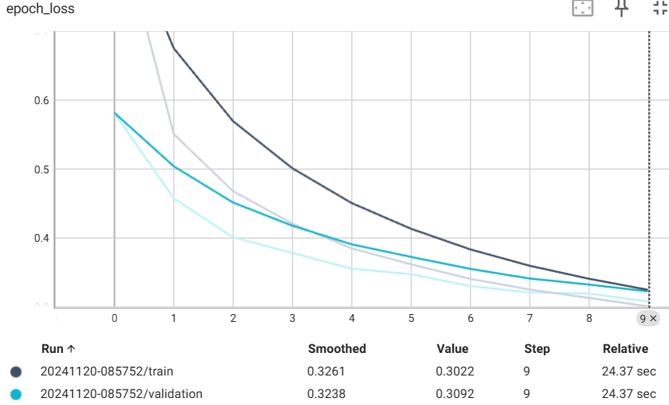
CNN Model Training
A3 – CNN model architecture :
3 Conv2D layers (32,5,5) (64,3,3) (128,3,3)
3 Maxpooling2D (2,2)
2 Dropout (0.3, 0.4)
1 Flatten
2 Dense layers (128, 50)
Training (10 epochs)
Train Accuracy: 0.8896, Validation Accuracy: 0.8835
Train Loss: 0.3022, Validation Loss: 0.3092

Slide 15
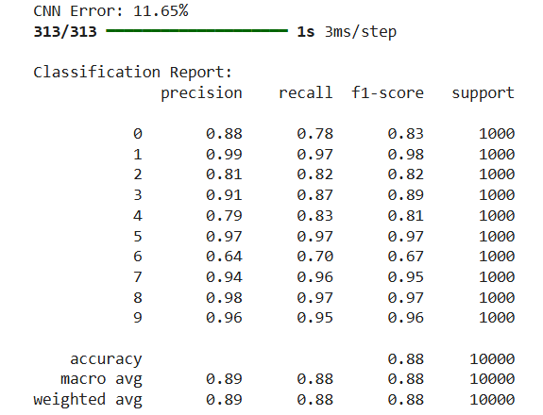
CNN Model Evaluation
A3 – CNN model Classification Report:
Accuracy: 0.88
CNN Error: 11.65%
Results of Accuracy and CNN Error are similar to model A2

Slide 16
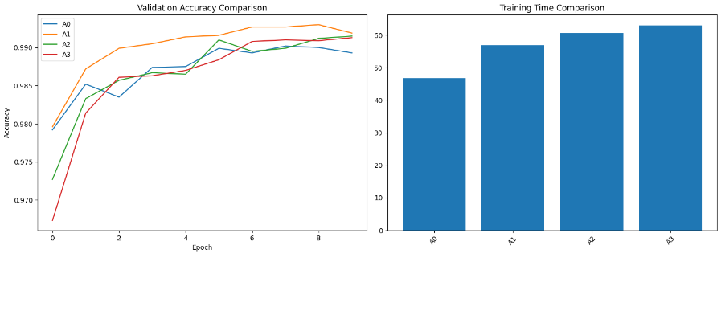
CNN Model Performance Comparison
We plot the Validation Accuracy curve combining all the model in a chart as shown on the right.
Model A1 outperforms the rest, scoring 90.95% validation accuracy
The training time used in Model A1 is moderate among the rest

Slide 17
Conclusion and Improvement
While training the CNN model, it is observed that model performance is hardly to improve by increasing layers and batch sizes
It could be due to small dataset size in Fashion-Mnist and may cause overfitting problem as the model architecture becomes more complex
By using 10 epochs in training the model seems to be optimal
Model A1 is recommended for model improvement and future deployment
We may consider using Hyperparameter tuning to further improve the model performance and robustness, here are some of the examples for consideration:
1. Data Augmentation – artificially expand the dataset and reduce overfitting
2. Optimize dropout rate, batch size
3. Explore different optimizer
4. Regularization – use L2 Regularization to penalize large weights and reduce overfitting

Slide 18
Thank You

